Slide 1
Early Literacy Skills
“The more that you read, the more things you will know. The more you learn, the more places you’ll go.” – Dr. Seuss

Slide 2
Nationally, only 35% of public school students were at or above Proficient in grade 4 reading.
In middle-income neighborhoods the ratio of books per child is 13 to 1, in low-income neighborhoods, the ratio is 1 age-appropriate book for every 300 children.
61% of low-income families have no books at all in their homes for their children.
37% of children arrive at kindergarten without the skills necessary for lifetime learning.
50% of children from low-income communities start first grade up to two years behind their peers.
Researchers estimate that before ever entering kindergarten, cognitive scores for children of low-income families are likely to average 60 percent lower than those in the highest socioeconomic groups (a pattern that remains true throughout high school).
Statistics from the National Institute for Literacy, National Center for Adult Literacy, The Literacy Company, and U.S. Census Bureau

Slide 3
Benefits of Reading
Develops a child's imagination
Improves concentration
Helps children to develop empathy
Improves vocabulary and language skills
Best way to develop and support children’s brains
Teaches children about the world around them, creating curious minds
Reading is fun!
Notes:
Brains are wired to be responsive to the sound of a human voice from birth.
Children learn language by listening to you speak.
Long before a baby can form understandable words, they will respond to you with noises, facial expressions and body language.

Slide 4
0-12 months old
Holds head steady, sits in lap without support
Pats picture to show interest
Talk back and forth with your baby
Puts book in mouth, drops, throws book
Make eye contact cuddle, talk, sing
Point at and name things: nose, ball, baby, dog, etc.
Choose books with pictures of baby faces, board and cloth books, rhymes
Notes:
Brains are wired to be responsive to the sound of a human voice from birth.
Children learn language by listening to you speak.
Long before a baby can form understandable words, they will respond to you with noises, facial expressions and body language.

Slide 5
1-3 years old
2-4 new words per day
Names familiar objects
Talk about the pictures
Use books in daily routines
Learns to turn paper pages, 2 to 3 pages at a time
Completes sentences and rhymes in familiar stories
Wants to read the same book again and again
Enjoys rhyming books; picture books that tell stories; search and finds
Notes:
Brains are wired to be responsive to the sound of a human voice from birth.
Children learn language by listening to you speak.
Long before a baby can form understandable words, they will respond to you with noises, facial expressions and body language.

Slide 6
3-4 years old
Sits still for longer stories
Scribbles and draws
Moves toward letter recognition
Begins to detect rhymes
Pretends to read to dolls and stuffed animals
Ask “What happens next?” in familiar stories
Makes up stories about the pictures
Enjoys picture books that tell longer stories; counting and alphabet books
Notes:
Brains are wired to be responsive to the sound of a human voice from birth.
Children learn language by listening to you speak.
Long before a baby can form understandable words, they will respond to you with noises, facial expressions and body language.

Slide 7
5-6 year old
Can listen longer
Recognizes numbers, letters
Relate the story to your child’s own experiences
Ask your child to tell the story
Encourage writing, drawing
Point out the letters in your child’s name
Enjoys fairy tales and legends; books with longer stories
Notes:
Brains are wired to be responsive to the sound of a human voice from birth.
Children learn language by listening to you speak.
Long before a baby can form understandable words, they will respond to you with noises, facial expressions and body language.

Slide 8
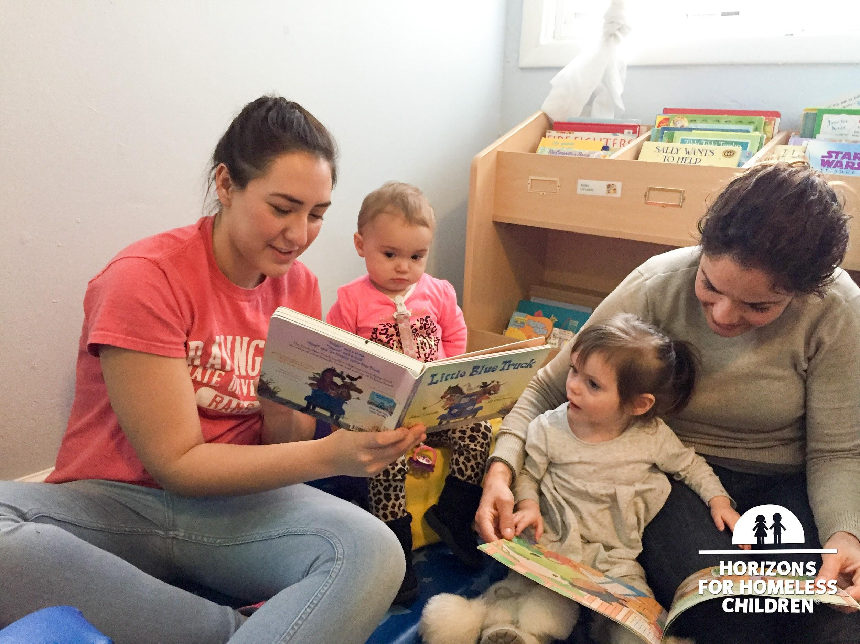
Keeping their Interest
Ask open-ended questions about the
story
Ask the child about before/ next
Make connections from the book to real life
Use voices to tell the story and make animal and vehicle sounds
Incorporate actions, such as making doggy ears with your hands
Notes:
Brains are wired to be responsive to the sound of a human voice from birth.
Children learn language by listening to you speak.
Long before a baby can form understandable words, they will respond to you with noises, facial expressions and body language.

Slide 9
Looking Ahead
Self-Esteem
Objective: Help children develop a positive sense of self and understand their worth.
Book: "The Wonderful Things You Will Be" by Emily Winfield Martin
Discussion: Talk about the qualities that make each child special. Encourage them to recognize their strengths, talents, and positive qualities.
Play Activity:
"Superhero Me!": Children create superhero characters with special powers based on their strengths. They can make capes, draw their superheroes.
Creative Expression:
Compliment Circle: In a circle, each child gives a compliment to the person next to them. This boosts confidence and teaches the importance of kindness.
Coping Skill Focus: When children feel unimportant, they can think about their strengths and how they contribute to the world.
Notes:
Brains are wired to be responsive to the sound of a human voice from birth.
Children learn language by listening to you speak.
Long before a baby can form understandable words, they will respond to you with noises, facial expressions and body language.

Slide 10
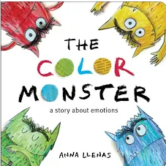
Looking Ahead
Feelings
Objective: Help children recognize and label their feelings and express them in healthy ways.
Book: "The Color Monster: A Pop-Up Book of Feelings" by Anna Llenas
Discussion: Explore different feelings (happy, sad, angry, scared, etc.) and discuss how they can recognize these feelings in themselves.
Play Activity:
Emotion Charades: Use flashcards with different emotions on them, and children take turns acting them out while others guess the emotion. This helps with emotional recognition and expression.
Creative Expression: Feelings Faces: Provide children with blank paper and encourage them to draw their faces showing different emotions. Discuss what triggers these feelings and how to manage them.
Coping Skill Focus: Teach children the importance of expressing their emotions appropriately and using breathing exercises to manage overwhelming feelings.
Notes:
Brains are wired to be responsive to the sound of a human voice from birth.
Children learn language by listening to you speak.
Long before a baby can form understandable words, they will respond to you with noises, facial expressions and body language.

Slide 11
Notes:
We’re happy to answer any questions you may have that we haven’t yet covered in the presentation. Feel free to raise your hand to ask a question, and be prepared to unmute too! We’ll also check the chat box for any submitted questions

Slide 12
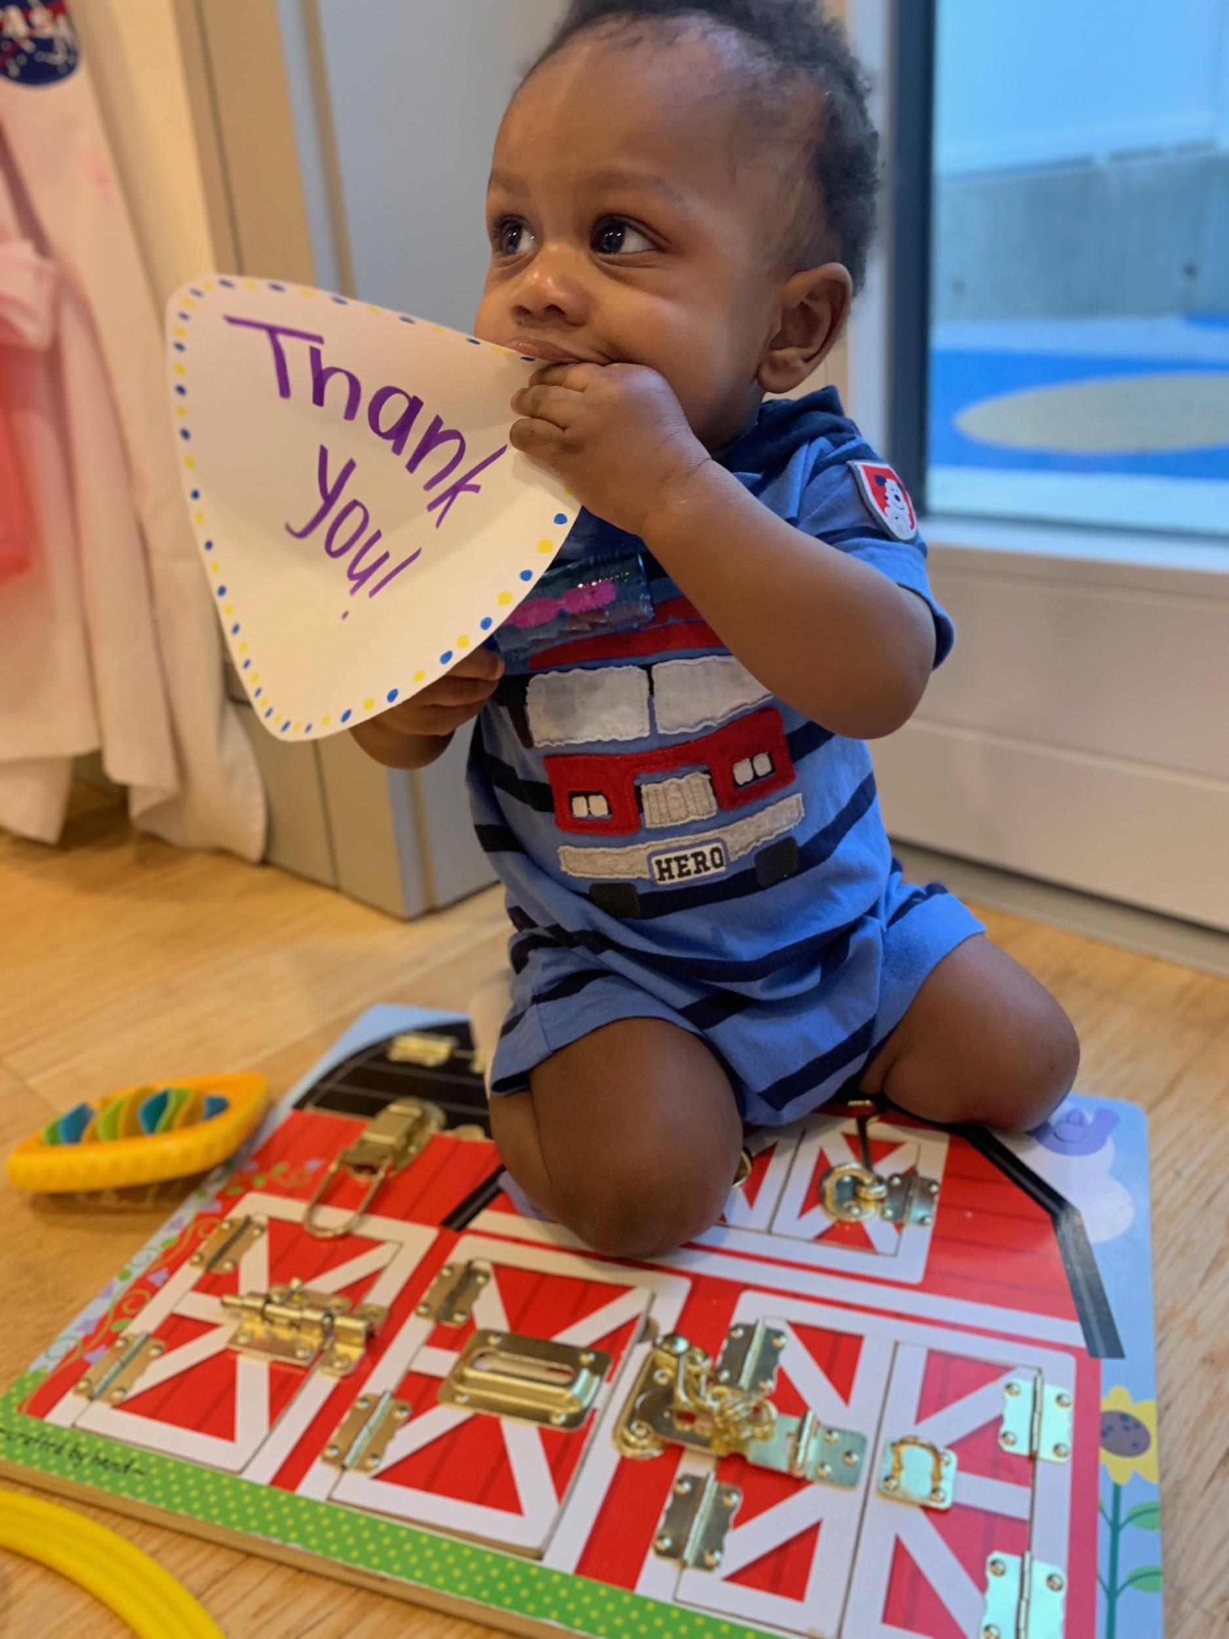
Thank you for joining us today!
Notes:
Thank you so much for being such amazing parents. We are grateful to be able to partner with you in your journey of raising amazing kids. We hope you consider joining us in the future for more workshops. Before you go, please consider filling out our follow up survey that will be shared with you after this workshop. Fill it out and you’ll receive a toy, book or material for your child.

